Slide 1



Machine Learning Project
Dr.Öğr.Üy. MUSTAFA ÇAVUŞ
FEHMİCAN KORKUTER
Melih GÜNDÜZ

Slide 2
Problem, Features, and Target
Problem
:
Predicting hotel reservation cancellations using various features.
Features
:
number of adults, number of children, number of weekend,nights, type of meal plan, required car parking space, room type reserved, lead_time, arrival year, arrival month, arrival date, market segment type , repeated guest, number of previous cancellations, number of previous bookings not canceled, average price per room number of special requests, booking status
booking status...
Target
:
The aim of the analysis is to create models according to the given features and predicting whether reservations are canceled or not and evaluating the performance of the models

Slide 3

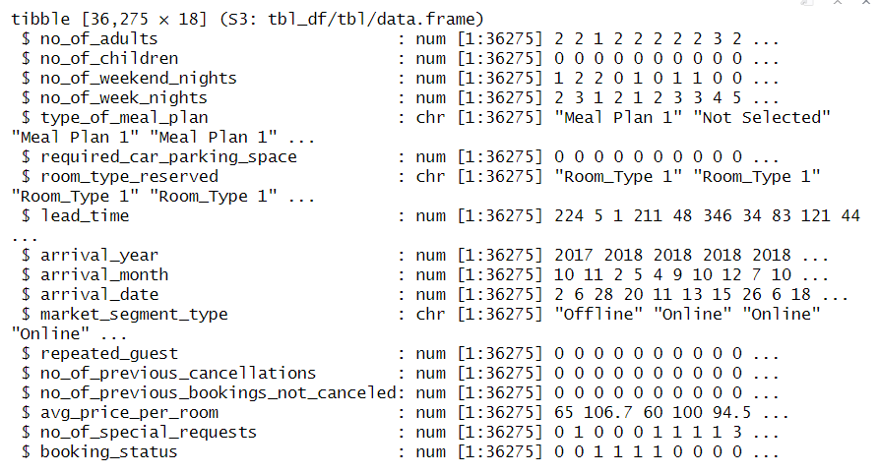
Dataset Overview
The dataset has a total of 36275 observations and 18 variables. Among these, 15 are numerical variables and 3 are categorical variables.

Slide 4


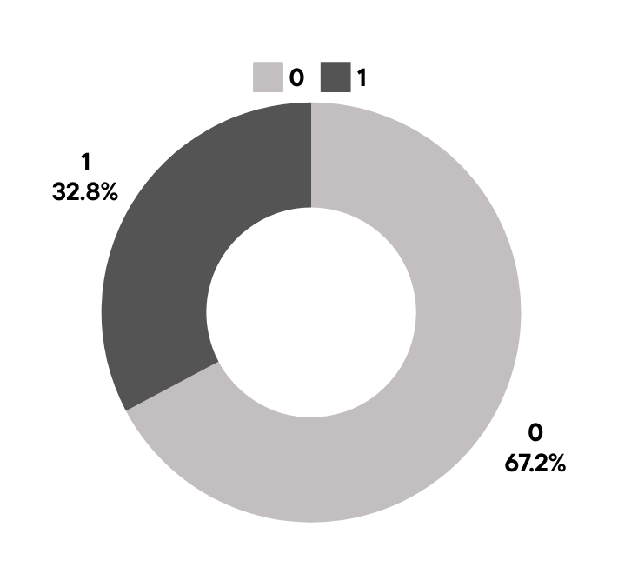
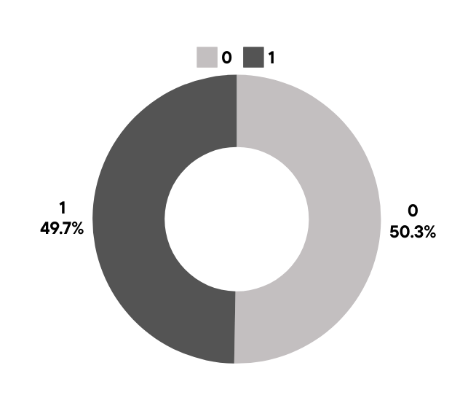
Check the imbalance problem
Oversample

Slide 5

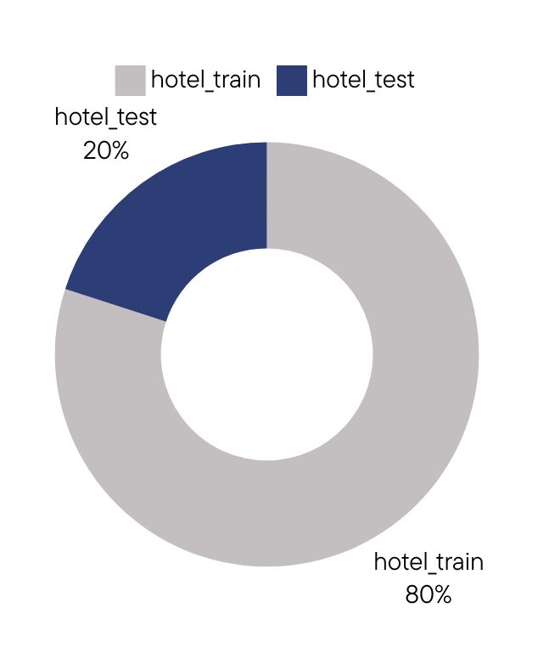
Splitting The Dataset

Slide 6

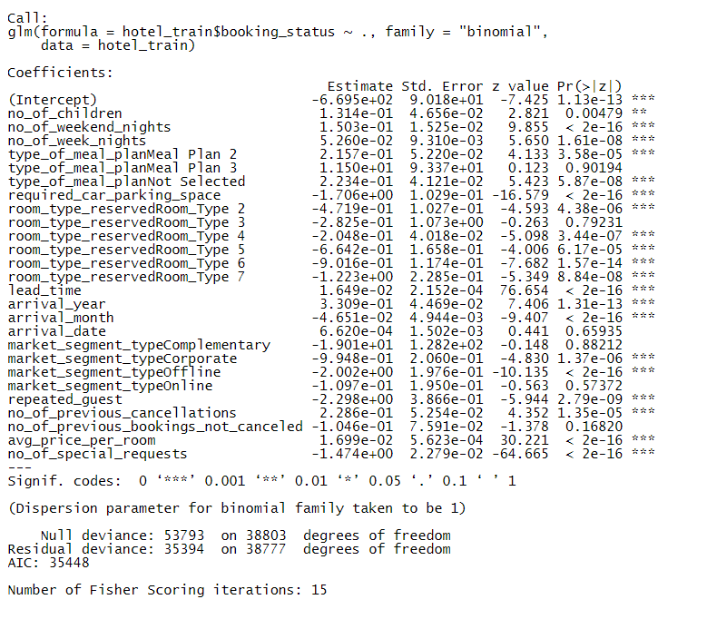
Train a Logistic Regression Model

Slide 7

Confusion Matrix
Confusion Matrix and Statistics | Confusion Matrix and Statistics | Confusion Matrix and Statistics
hotel_classes | hotel_classes | hotel_classes
 | 0 | 1
0 | 3825 | 1082
1 | 1097 | 3697
Accuracy | 0.7754 | Pos Pred Value | 0.7712
95% CI | 0.7969-0.7837 | Neg Pred Value | 0.7795
No Information Rate | 0.5074 | Prevalence | 0.4926
P- Value [Acc > NIR] | <2e-16 | Detection Rate | 0.3811
Kappa | 0.5507 | Detection Prevalence | 0.4942
Mcnemar's Test P-Value | 0.7642 | Balanced Accuracy | 0.7754
Sensitivity | 0.7736 | 'Positive' Class | 1
Specificity | 0.7771

Slide 8
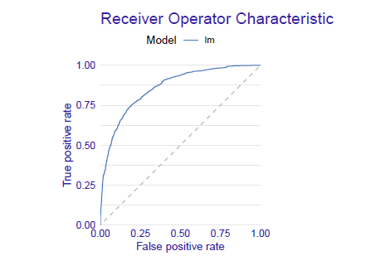
ROC Curve
Measures for | classification
recall | 0.7711723
precision | 0.7735928
f1 | 0.7723807
accuracy | 0.775384
auc | 0.8601501

Slide 9


Decision Tree
0
0,50
100%
YES
NO
lead time < 152
0
0.38
74%
no of special requests >= 0.5
0
0.50
42%
market segment type
1
0.69
24%
lead time < 8.5
0
0.22
32%
0
0.25
18%
0
0.32
4%
1
0.76
20%
1
0.84
26%

Slide 10
Confusion Matrix
Truth | Truth | Truth
Prediction | 0 | 1
0 | 4029 | 1254
1 | 878 | 3540
Metric | estimator | estimate
accuracy | binary | 0.780
Metric | estimator | estimate
sensivity | binary | 0.821
Metric | estimator | estimate
f_meas | binary | 0.791

Slide 11
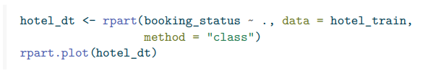
The Overfitting Problem This code collects the necessary information to measure the performance of the decision tree model in the dataset.
0
0,50
100%
YES
NO
lead time < 152
0
0.38
74%
no of special requests >= 1
0
0.50
42%
market_segment_type = Complementary,Corporate,Offline
1
0.69
24%
lead time < 9
0
0.22
32%
0
0.25
18%
0
0.32
4%
1
0.76
20%
1
0.84
26%

Slide 12
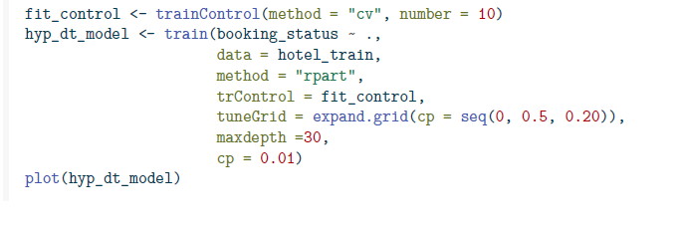
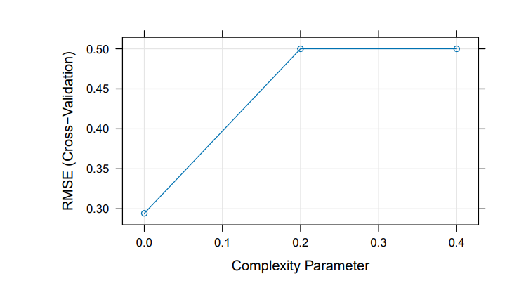
Improve The Prediction Performance Of The Decision Tree
Model Tuning Hyperparameters (Grid Search in Caret)

Slide 13
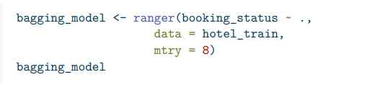
Training Bagging Model
Type | Regression
Number of trees | 500
Sample size | 38804
Number of independent variables | 17
Mtry | 8
Target node size | 5
Variable importance mode | none
Splitrule | variance
OOB prediction error (MSE): | 0.04548852
R squared (OOB): | 0.8180474

Slide 14
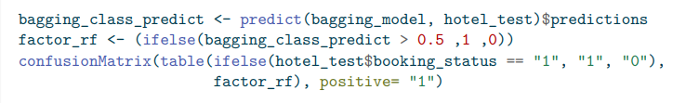
Confusion Matrix
Confusion Matrix and Statistics | Confusion Matrix and Statistics | Confusion Matrix and Statistics
factor_rf | factor_rf | factor_rf
 | 0 | 1
0 | 4582 | 325
1 | 223 | 4571
Accuracy | 0.9435 | Pos Pred Value | 0.9535
95% CI | 0.9387, 0.948 | Neg Pred Value | 0.9338
No Information Rate | 0.5047 | Prevalence | 0.5047
P- Value [Acc > NIR] | < 2e-16 | Detection Rate | 0.4712
Kappa | 0.887 | Detection Prevalence | 0.4942
Mcnemar's Test P-Value | 1.6e-05 | Balanced Accuracy | 0.9436
Sensitivity | 0.9336 | 'Positive' Class | 1
Specificity | 0.9536

Slide 15

Thank you

